Slide 1
DATA SCIENCE
PYTHON FOR DATA SCIENCE AND AI
By:
Anil Kushwaha
11503173

Slide 2
outline
What Is Data Science?
Data Science Methodology
Project
Juypter Notebook
Data Science Applications

Slide 3
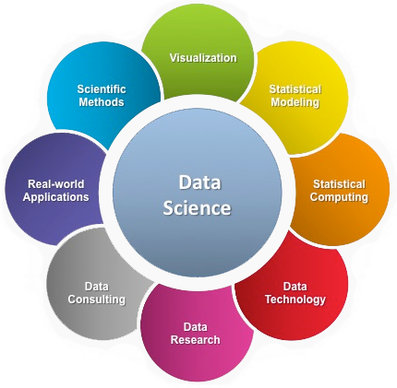
What is data science?
Data science is the study of data. It involves developing methods of recording, storing, and analyzing data to effectively extract useful information. The goal of data science is to gain insights and knowledge from any type of data — both structured and unstructured.

Slide 4
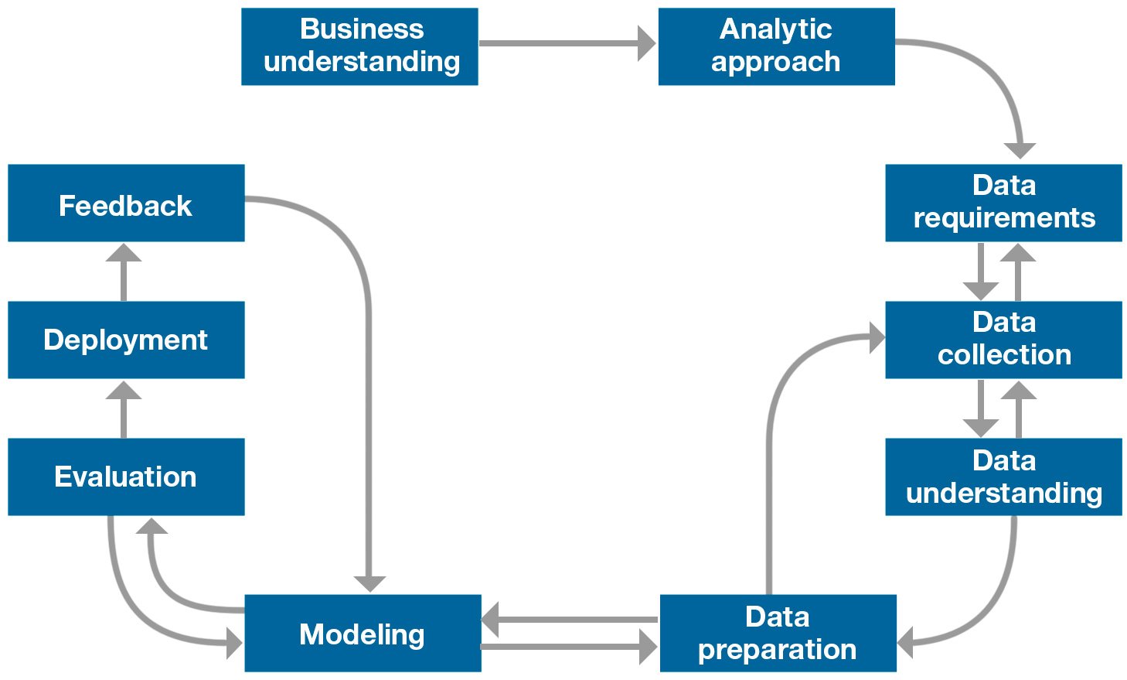
Data science methodology

Slide 5

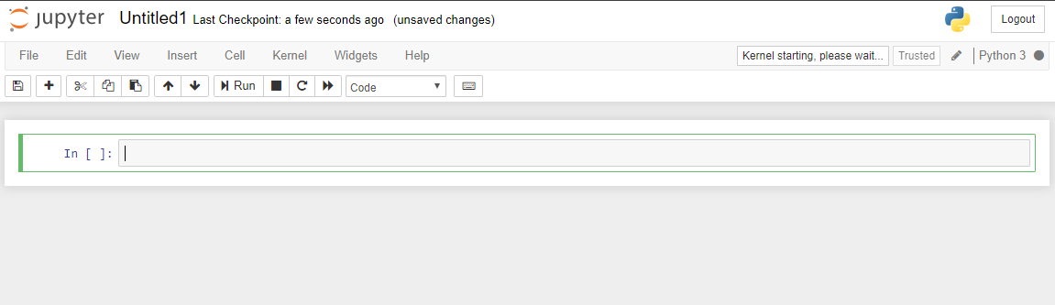
Jupyter notebook
The Jupyter Notebook is an open-source web application that allows you to create and share documents that contain live code, equations, visualizations and narrative text. Uses include: data cleaning and transformation, numerical simulation, statistical modeling, data visualization, machine learning, and much more.

Slide 6
Data Science Applications
Transaction Databases → Recommender systems (NetFlix), Fraud Detection (Security and Privacy)
Wireless Sensor Data → Smart Home, Real-time Monitoring, Internet of Things
Text Data, Social Media Data → Product Review and Consumer Satisfaction (Facebook, Twitter, LinkedIn), E-discovery.

Slide 7
Project work New User Bookings
Data preprocessing
Exploratory Data Analysis

Slide 8
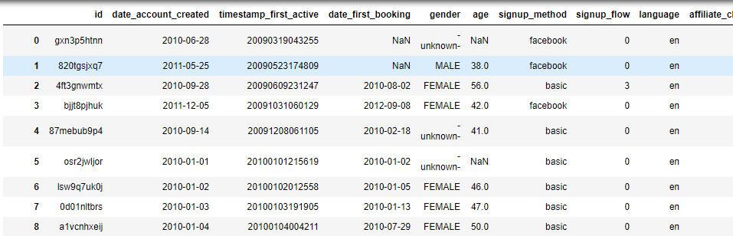
Loading CSV File and showing the table

Slide 9
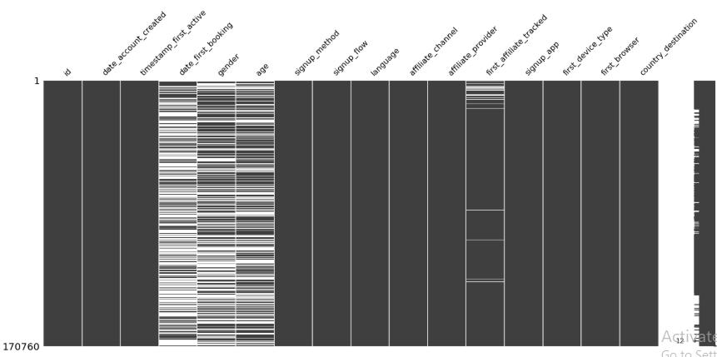
Showing the Box plot with lot of missing values in gender , age

Slide 10
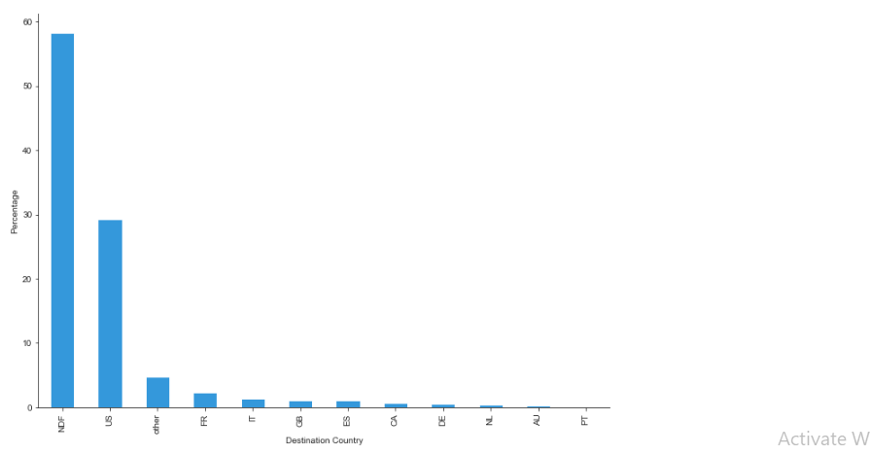
users travelled in their home country, Users did not travel anywhere….
57% of users in Train data set did not travel anywhere .
28 % of users travelled in their home country i.e ..,U.S

Slide 11
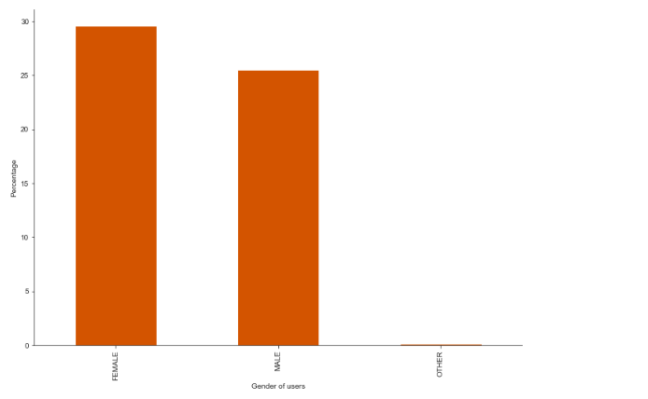
Gender of users
45 % of user's gender information is not present
There is less difference between Female and Male users.

Slide 12
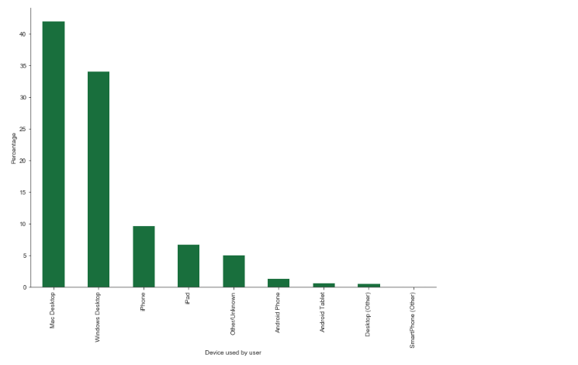
Device used by user
58% users are using Apple products .
Out of 71,719 users who travelled atleast once,31660 users are apple users [44.15%] which implies Mac users are booking more frequently

Slide 13
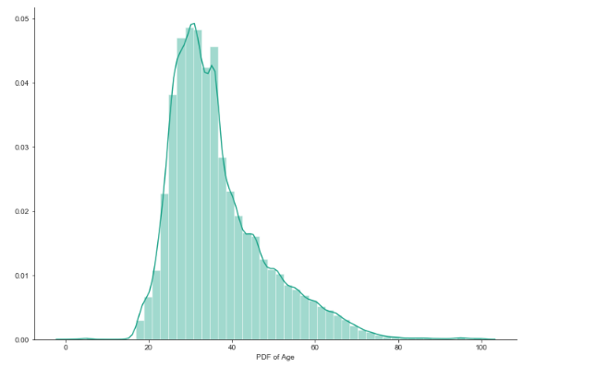
Users age’s
Majority of the users are between age 25 and 40 years . [ 72% ]
There are some age values which are less than 18 years [ 0.006% ](not allowed)

Slide 14
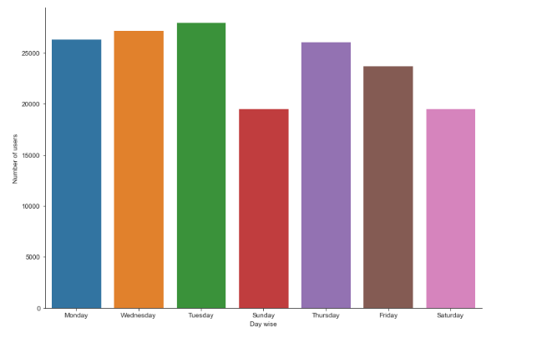
User’s day wise activity
User activity is low on Saturday and Sunday . So chance of booking on Saturdays , Sundays is pretty low.

Slide 15
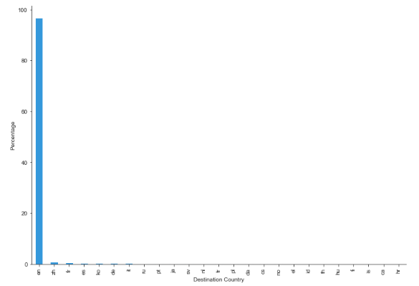
user's language preference
Majority of the user's language preference is English (96.67%) . But it is still questionable because most of users are from US
Predicting geo location of users based on language preference may be useful

Slide 16
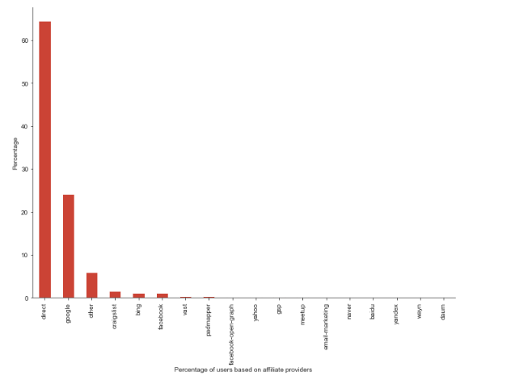
From which Sources users are coming
In this plot we observe that most of users are coming from which source

Slide 17
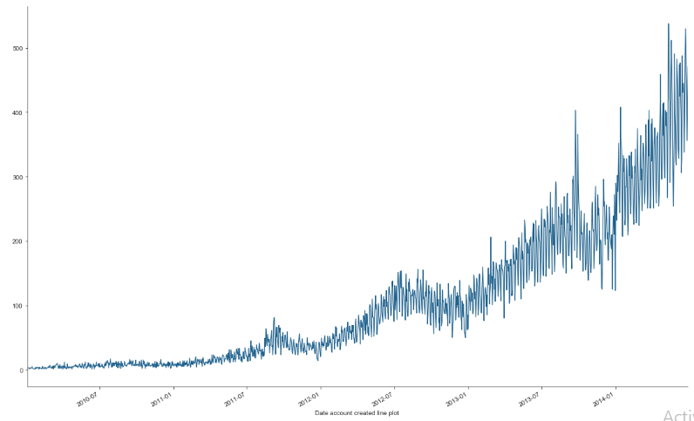
year wise Activity of user’s
Every year increase in Activity of users

Slide 18


